Slide 1

ReactJS
2019.4.1 – 4.5 – 5.12
Y

Slide 2
멀티캠퍼스 ReactJS 프로그래밍 강의
원형섭 (40살 2019년 현재)
http://www.opensg.net/
stepanowon@hotmail.com
https://github.com/stepanowon
https://github.com/stepanowon/react-quickstart
http://homoefficio.github.io/2015/07/21/Cross-Origin-Resource-Sharing/
https://github.com/stepanowon/contactsvc
2019.4.1 - 5

Slide 3
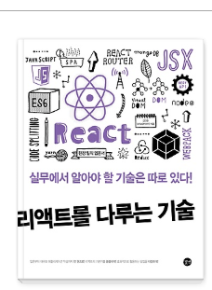


Books
2019.4.1 - 5

Slide 4

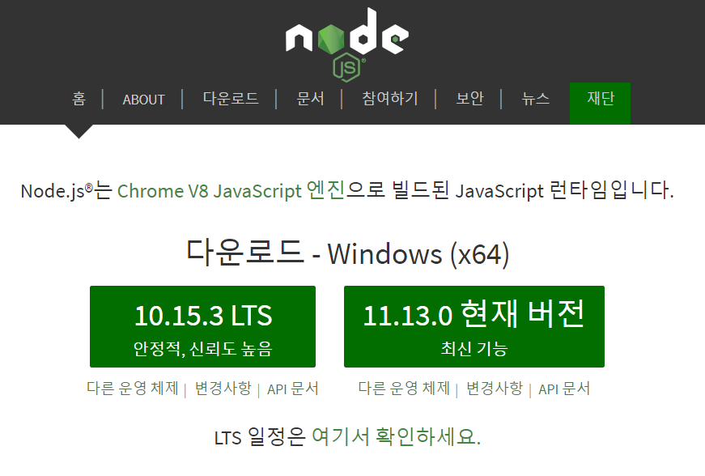
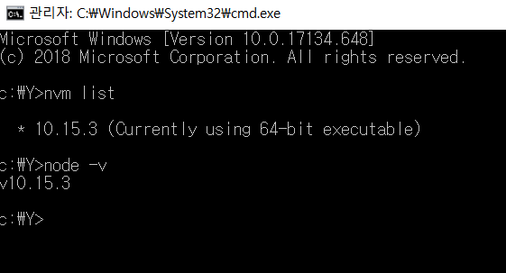
node.js
https://nodejs.org/ko/
node-v10.15.3-x64.msi
2019.4.1 - 5

Slide 5
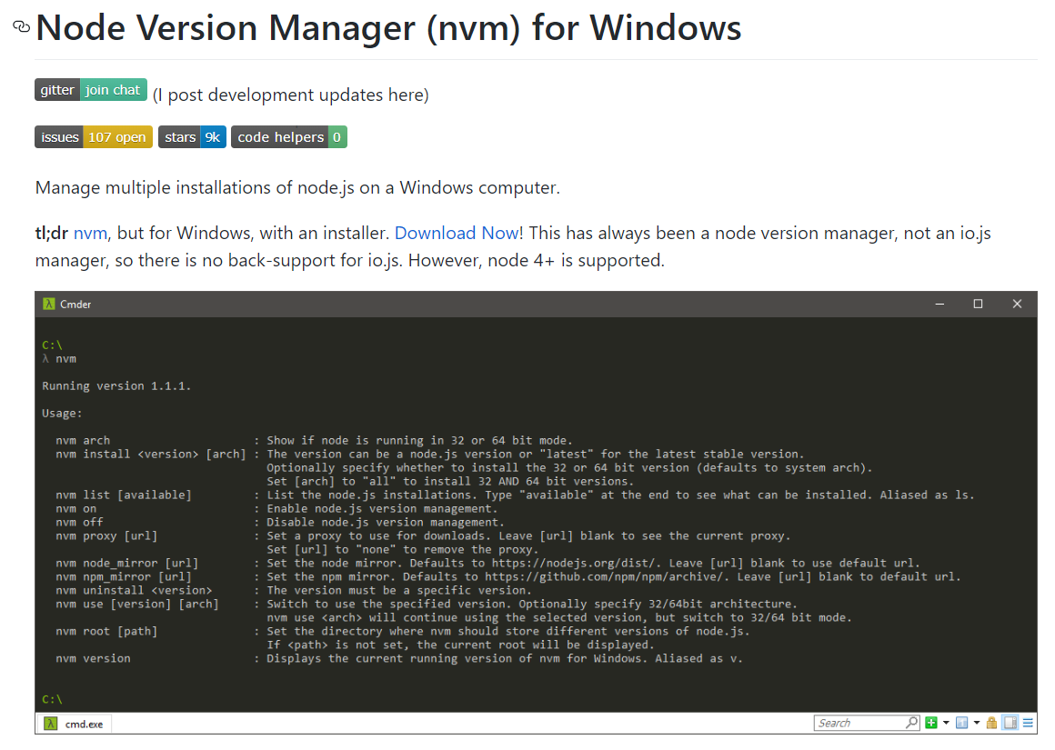
node.js: Node Version Manager (nvm) for Windows
https://github.com/coreybutler/nvm-windows
nvm list
nvm install 8.9.3
nvm use 8.9.3
2019.4.1 - 5

Slide 6

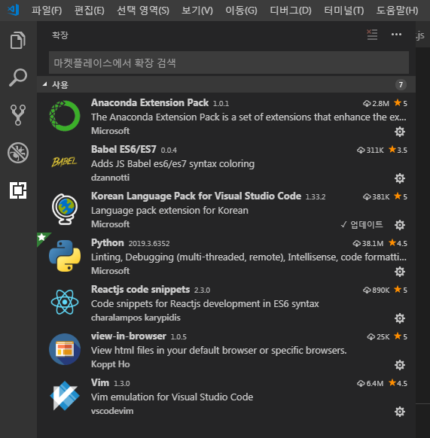
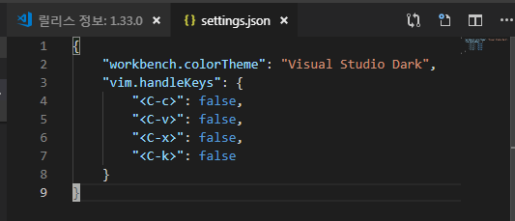

Visual Studio Code
https://code.visualstudio.com/docs/nodejs/reactjs-tutorial → MERN (MongoDB, Express, React, Node.js) → Next.js
Plug Extension
settings.json
Server-side
rendering
Extensions (Ctrl+Shift+X)
Command Palette (Ctrl+Shift+P)
2019.4.1 – 5, 4.30, 5.11

Slide 7
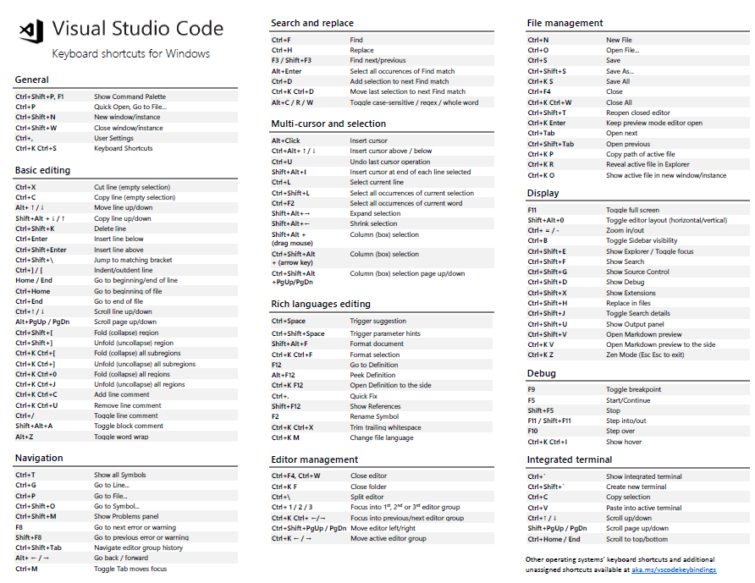
Visual Studio Code: Shortcuts
https://code.visualstudio.com/shortcuts/keyboard-shortcuts-windows.pdf
2019.4.1 - 5

Slide 8

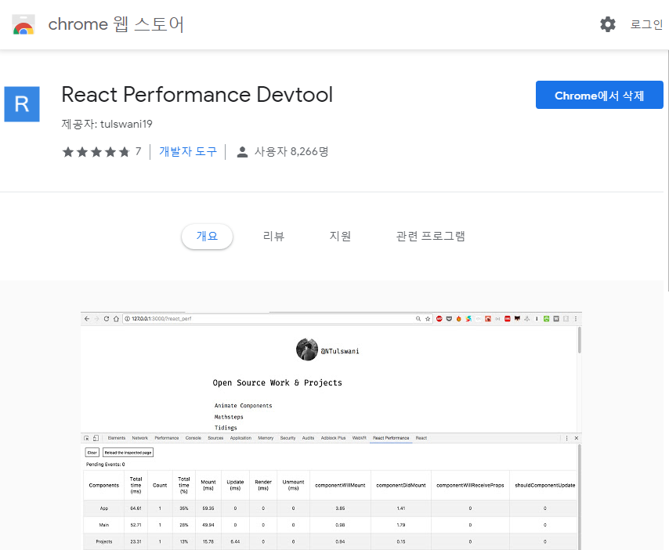
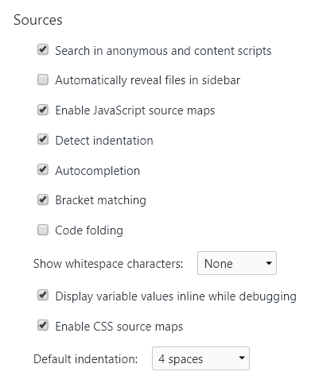
Chrome
크롬/도구더보기/확장프로그램/(왼쪽)확장프로그램아이콘/Chrome 웹 스토어 열기
스토어 검색: react developer tools
open development tool: ctrl + shift + i
change settings: 1) check Sources/Enable JavaScript source maps, 2) Search in anonymous and content scripts
yarn start
2019.4.1 – 5, 4.26

Slide 9
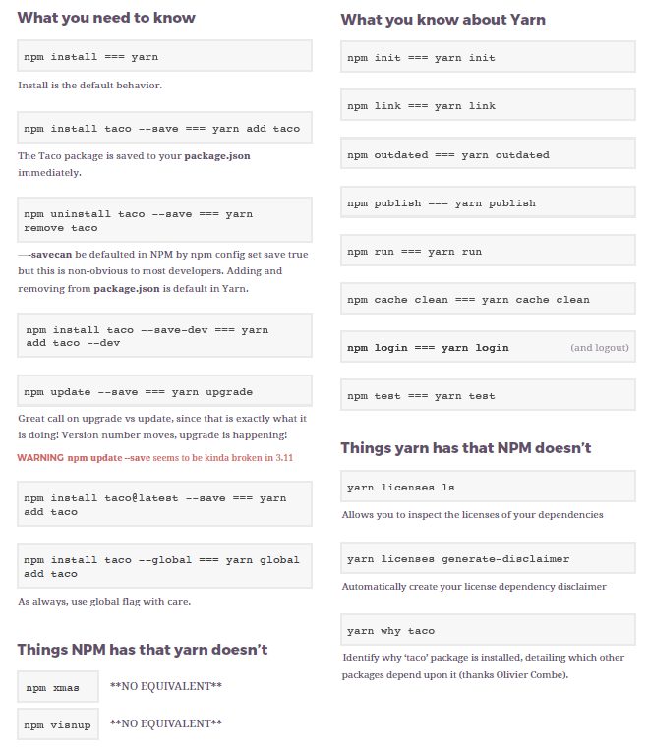
NPM Vs. Yan
https://infinite.red/files/yarn.pdf
2019.4.1 - 5

Slide 10
Back-end to Front-end w/ node.js, express, react
Web page
Web page
Web page
Express App
React App
Front-End
Middle-End
(Middleware)
express-generator
create-react-app
Back-End
node.js
2019.4.18

Slide 11
React Features
Fast rendering; good for real time display of data
Use virtual DOM for fast rendering
Component based development: Integration of Markup, JavaScript code, Style
JSX (JavaScript XML) for markup integration
Combination of UI, not inheritance
SPA (Single page application); easy to make hybrid app
hybrid app: web-based desktop application, electron (visual studio code) 1) well made library for state management (Redux, Mobx) 2) good library for routing management (react-router)
One-way data binding to UI
2019.4.1 - 5

Slide 12
ReactJS - Chapter 1 -

Slide 13
React Global Modules in node.js
yarn
Install
npm install –g yarn
Manual
https://infinite.red/files/yarn.pdf
Create React App
Install
npm install -g create-react-app
Document
https://facebook.github.io/create-react-app/docs/getting-started
2019.4.1 - 5

Slide 14
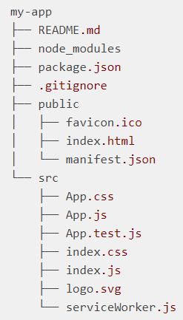
React Local Modules: Create React App Project
https://facebook.github.io/create-react-app/docs/getting-started
Create React App is an officially supported way to create single-page React applications.
Quick Start
yarn create react-app my-app
cd my-app
yarn add <module>
npm start or » yarn run start or » yarn start
[chrome browser] localhost:3000
Install modules
yarn add bootstrap@4.x.x react-bootstrap@1.x.x
yarn add immer or » yarn add immutability-helper
yarn add redux react-redux
yarn add redux-thunk
yarn add –D redux-immutable-state-invariant redux-devtools-extension
yarn add react-router react-router-dom react-router-config
yarn add @material-ui/core @material-ui/icons @material-ui/docs
yarn add recharts
yarn add –exact react-script@2.1.8
refer to package.json
included in react-router 5.0+
2019.4.1 – 5, 4.8, 4.9, 4.22, 4.24 ,4.27, 4.29, 4.30, 5.9

Slide 15
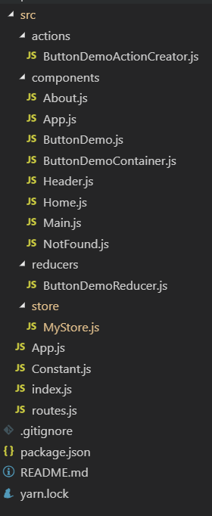
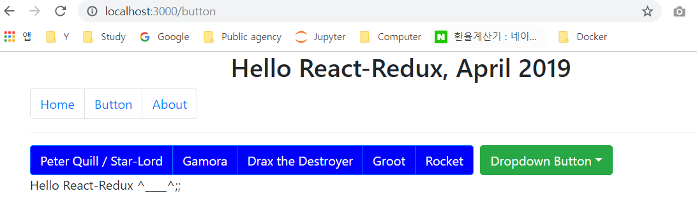
Hello-React-Redux
2019.4.22 - 23

Slide 16
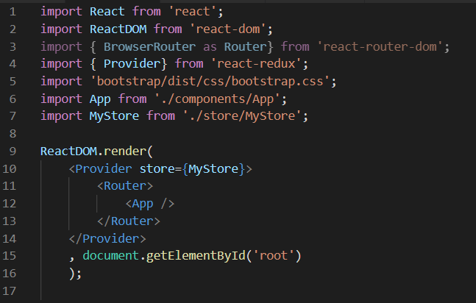
Hello-React-Redux: index.js ^{1/14}
2019.4.22 - 23

Slide 17
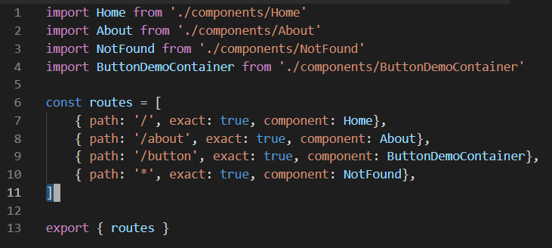
Hello-React-Redux: routes.js ^{1/14}
2019.4.22 - 23

Slide 18

Hello-React-Redux: constant.js ^{1/14}
2019.4.22 - 23

Slide 19
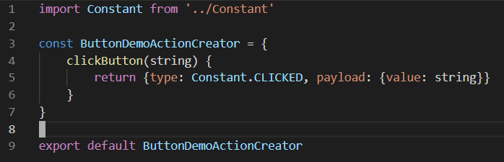
Hello-React-Redux: ButtonDemoActionCreator.js ^{1/14}
2019.4.22 - 23

Slide 20
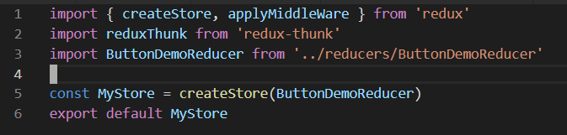
Hello-React-Redux: MyStore.js ^{1/14}
2019.4.22 - 23

Slide 21
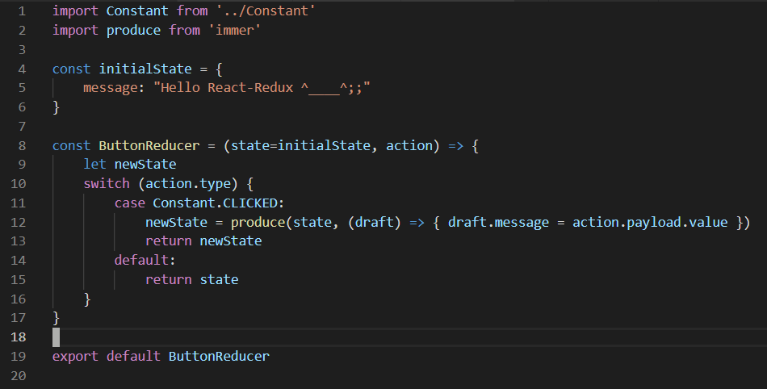
Hello-React-Redux: ButtonDemoReducer.js ^{1/14}
2019.4.22 - 23

Slide 22
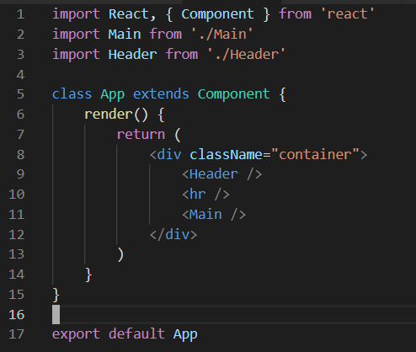
Hello-React-Redux: App.js ^{1/14}
2019.4.22 - 23

Slide 23
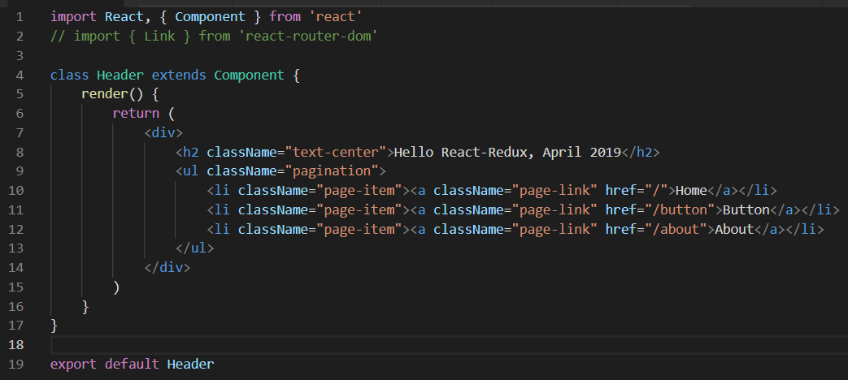
Hello-React-Redux: Header.js ^{1/14}
2019.4.22 - 23

Slide 24
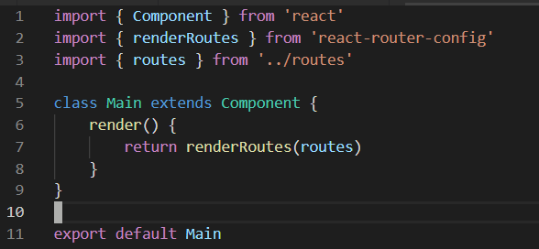
Hello-React-Redux: Main.js ^{1/14}
2019.4.22 - 23

Slide 25
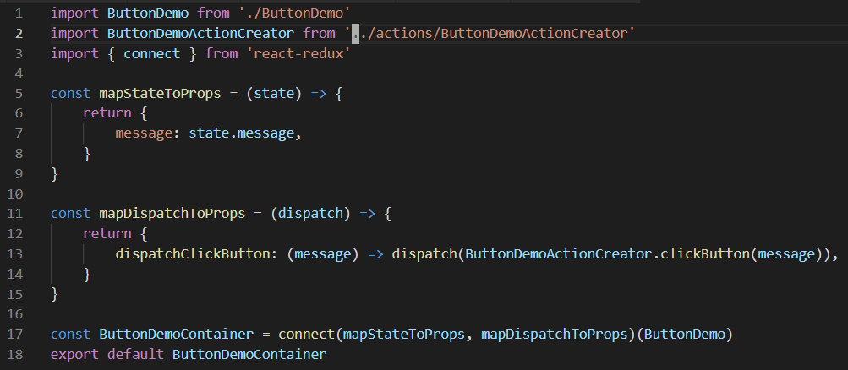
Hello-React-Redux: ButtonDemoContainer.js ^{1/14}
2019.4.22 - 23

Slide 26
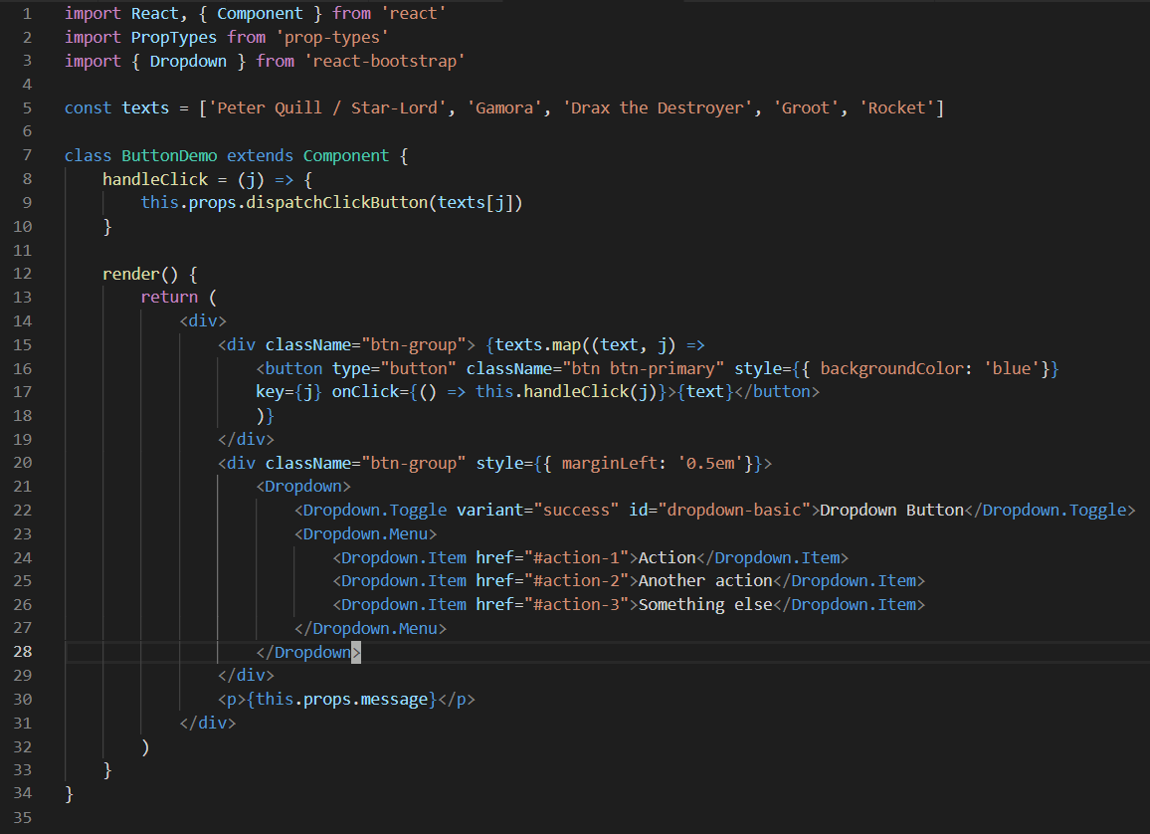
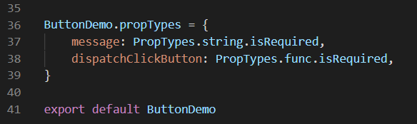
Hello-React-Redux: ButtonDemo.js ^{1/14}
2019.4.22 - 23

Slide 27
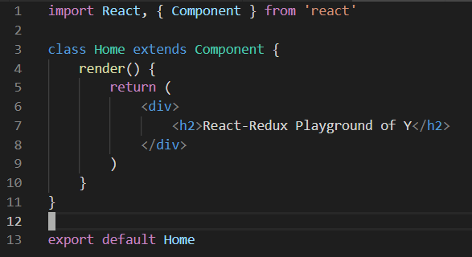
Hello-React-Redux: Home.js ^{1/14}
2019.4.22 - 23

Slide 28
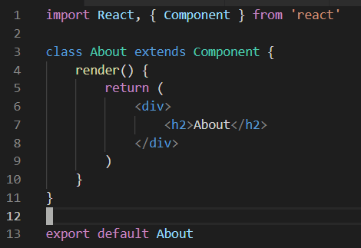
Hello-React-Redux: About.js ^{1/14}
2019.4.22 - 23

Slide 29
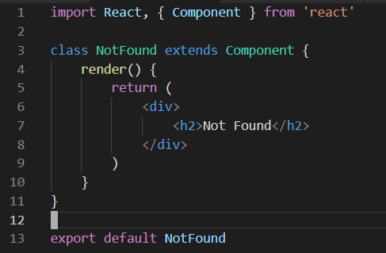
Hello-React-Redux: NotFound.js ^{1/14}
2019.4.22 - 23

Slide 30
ReactJS - Chapter 2 -

Slide 31
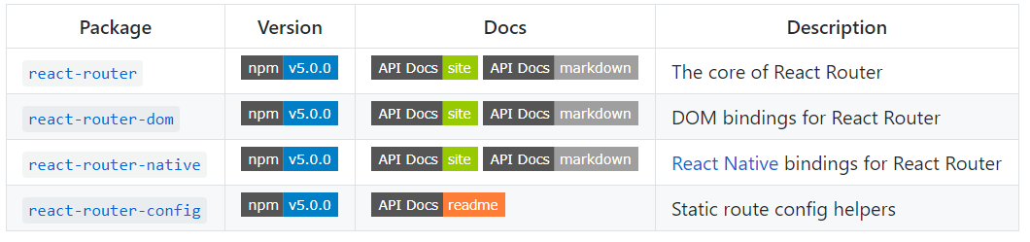
React-Router
https://github.com/ReactTraining/react-router
2019.4.9

Slide 32
How to show React App in ie11
https://github.com/facebook/create-react-app/tree/master/packages/react-app-polyfill
https://stackoverflow.com/questions/25557299/internet-explorer-11-disable-display-intranet-sites-in-compatibility-view-via
How to install
yarn add react-app-polyfill or » npm install react-app-polyfill
yarn add --exact react-scripts@2.1.8 or » npm install --save --save-exact react-scripts@2.1.8
* Don’t use ‘reat-script@3.3.0’; use @2.1.8 instead
Add to the first line of src/index.js [1]
import 'react-app-polyfill/ie11’;
import 'react-app-polyfill/stable’;
Add to public/index.html [2]
<meta http-equiv="X-UA-Compatible" content="IE=EDGE" />
Build
yarn build
2019.5.9 - 11

Slide 33
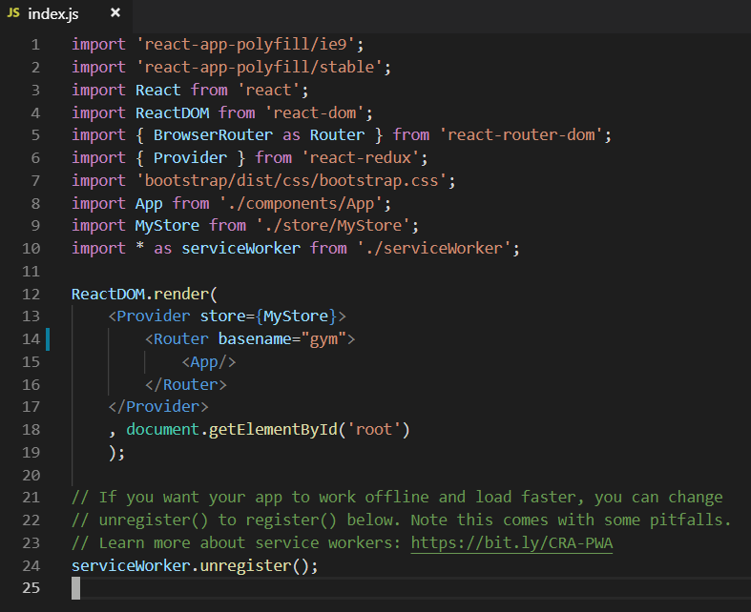
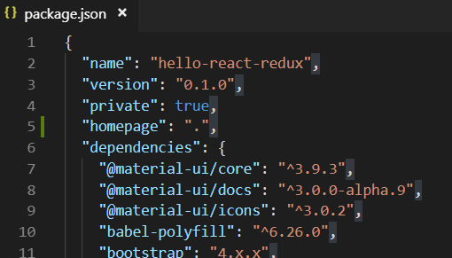
How to build relative path (base URL) of React App
[1] https://facebook.github.io/create-react-app/docs/deployment
[2] https://reacttraining.com/react-router/web/api
[3] e-mail communication with 원형섭강사 in April 2019
Edit src/index.js [1, 2]
<Router basename=“gym”>
</Router>
Add to package.json
“homepage”: “.”
Use react-scripts@2.18; Do not use @.3.0.0 [3]
2019.5.9 - 10

Slide 34
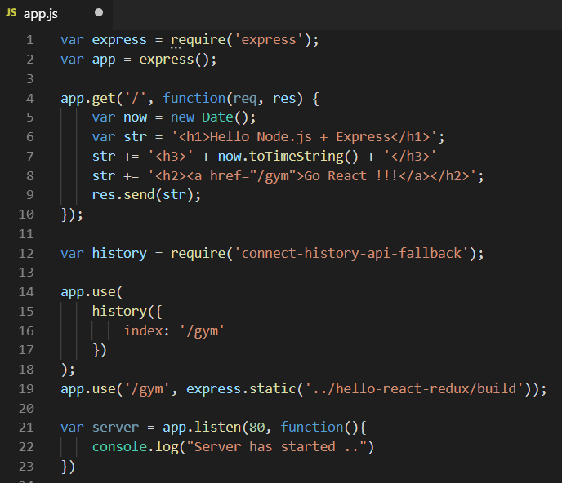
How to test React App with backend: node.js
[1] e-mail communication with 원형섭강사 in April 2019
[2] https://github.com/stepanowon/react_deploy_sample/blob/master/hello-react-redux/package.json
How to create local server
express <localServer>
cd <localServer>
yarn add connect-history-api-fallback
nodemon app.js
Build
cd <myProject>
yarn build
Browse in chrome or ie9/10/11
localhost:80
or x.x.x.x/<relative path>
2019.5.9 - 11

Slide 35
Scripts in package.json
[1] e-mail communication with 원형섭강사 in April 2019
[2] https://github.com/stepanowon/react_deploy_sample/blob/master/hello-react-redux/package.json
“scripts”: {
"start": "react-scripts start",
"build": "react-scripts build",
"test": "react-scripts test",
"eject": "react-scripts eject",
“rm&cp": "rimraf ../backend/gym && move-cli build ../backend/gym",
"deploy": "npm run build && npm run rm&cp“
}
2019.5.9 - 11

Slide 36
How to remove/disable webpack source-map
https://www.npmjs.com/package/rimraf
How to install
yarn add -D rimraf
Edit package.json
"scripts": {
"start": "react-scripts start",
"build": "react-scripts build",
"build:nomap": "react-scripts build && rimraf build/**/*.map",
"test": "react-scripts test",
"eject": "react-scripts eject"
},
2019.5.4

Slide 37
Cross Origin Problem
<src/setupProxy.js>
const proxy = require('http-proxy-middleware');
module.exports = function(app) {
app.use(
proxy('/api', {
target: 'http://localhost:3001',
changeOrigin: true,
pathRewrite: {
'^/api':''
}
})
);
};
2019.4.1 - 5

Slide 38
How to disable disable-react-devtools
https://github.com/fvilers/disable-react-devtools#readme
How to install
yarn add @fvilers/disable-react-devtools
How to use
import React from 'react';
import ReactDOM from 'react-dom';
import { disableReactDevTools } from '@fvilers/disable-react-devtools';
import App from './App';
if (process.env.NODE_ENV === 'production') {
disableReactDevTools();
}
ReactDOM.render(<App />, document.getElementById('root'));
2019.5.4

Slide 39
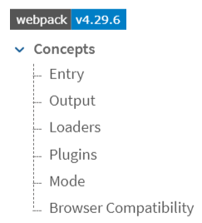
Webpack
https://webpack.js.org/
2019.4.1 - 5

Slide 40
Webpack
Babel
Babel is a JavaScript compiler to convert ES2015+ to ES5
Install
npm install --save-dev babel-cli babel-core babel-preset-env babel-preset-stage-2
Document
http:/babeljs.io/repl
create .babelrc
Source-maps ????
Webpack
Install
npm install -g webpack webpack-cli
npm install –save-dev webpack-dev-serv
Document
https://webpack.js.org/
2019.4.1 - 5

Slide 41

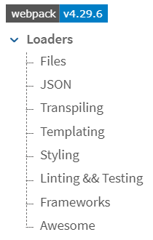
Webpack: Loader ^{1/2}
https://webpack.js.org/loaders/
https://github.com/webpack-contrib/awesome-webpack#laoders
2019.4.8

Slide 42

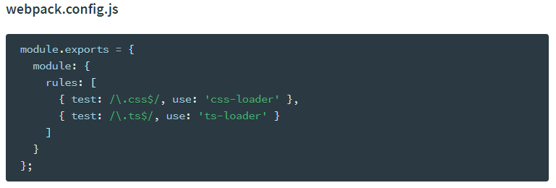
Webpack: Loader ^{2/2}
https://webpack.js.org/concepts/loaders
예가 뭘까요 어떻게 사용하는 건가요 ? ???
2019.4.1 - 5

Slide 43
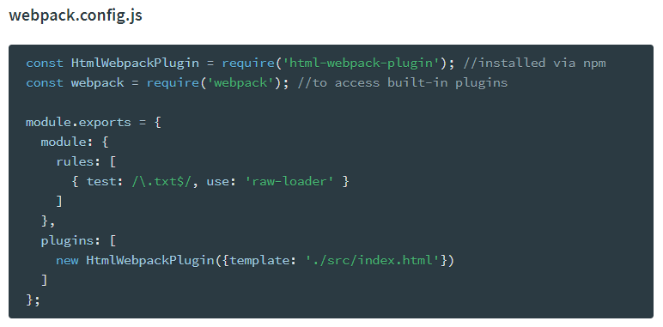
Webpack: Plugin
https://webpack.js.org/concepts/plugins/
2019.4.1 - 5

Slide 44
Webpack: webpack.config.js
webpack loader
webpack.config.js
xxx
2019.4.1 - 5

Slide 45
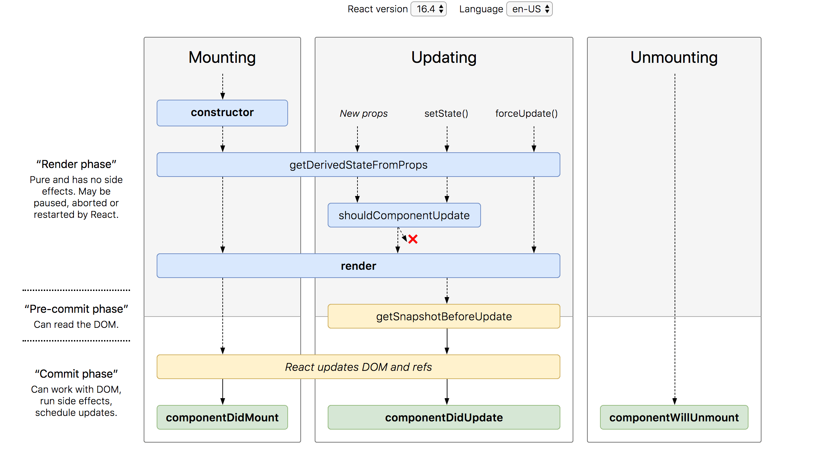
Lifecycle Method
http://projects.wojtekmaj.pl/react-lifecycle-methods-diagram/ ★★★
https://programmingwithmosh.com/javascript/react-lifecycle-methods/
No need to use this if you use PureComponent
If return true
Update browser DOM
componentDidCatch???
2019.4.1 - 5

Slide 46
HOC (High Order Component)
React render ???
React dnd >> 에니메이션
2019.4.1 - 5

Slide 47
React Folder: index.js
import React from 'react';
import ReactDOM from 'react-dom';
import './index.css';
import 'bootstrap/dist/css/bootstrap.css';
import App from './App';
import * as serviceWorker from './serviceWorker';
ReactDOM.render(<App />, document.getElementById('root'));
// If you want your app to work offline and load faster, you can change
// unregister() to register() below. Note this comes with some pitfalls.
// Learn more about service workers: https://bit.ly/CRA-PWA
serviceWorker.unregister();
2019.4.1 - 5

Slide 48
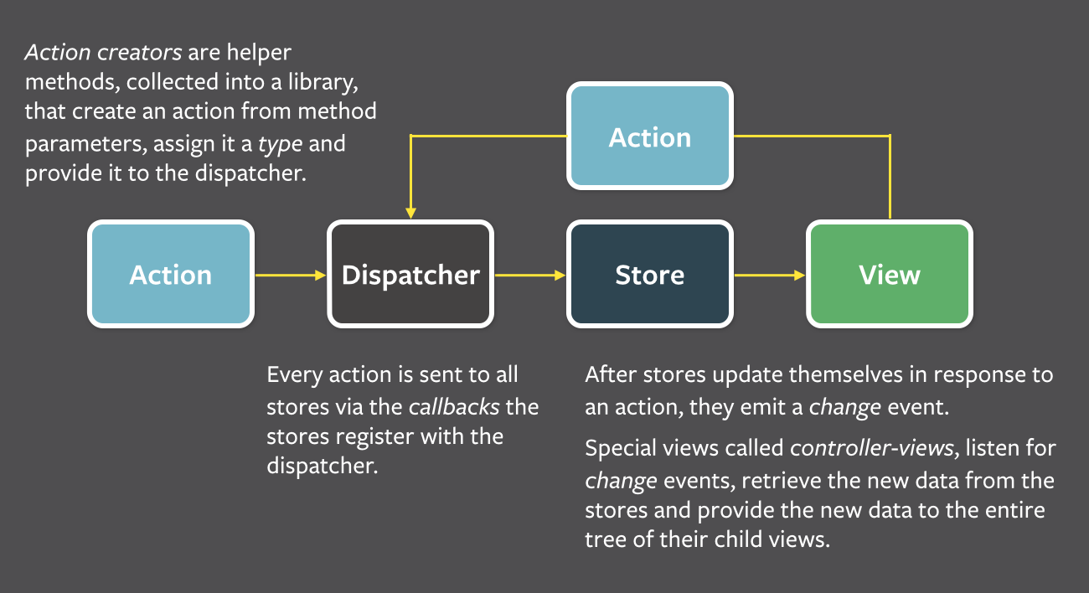
Flux
https://facebook.github.io/flux/docs/overview.html
2019.4.1 - 5

Slide 49
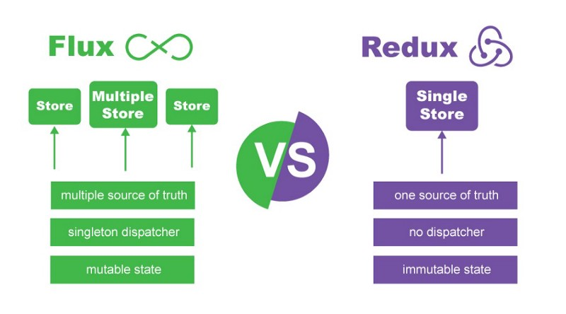
Redux
Redux = Flux + hot reloading + time travel debugging
Flux issues:
Integration of state and state-logic → side effect: if logic changed, state becomes initialized.
Not able to debug time travel
Redux features:
Single store ^{[1]}
Separation of state and state-logic
Time travel debugging ^{[2]}
Three Principles ^{[3]}:
Single source of truth (SSOT) ^{[4]}
State is read-only
Changes are made with pure function
[1] Redux single store: https://redux.js.org/api/store
[2] Time travel debugging: https://en.wikipedia.org/wiki/Time_travel_debugging
[3] Three Principles: https://redux.js.org/introduction/three-principles
[4] Single source of truth (SSOT): https://en.wikipedia.org/wiki/Single_source_of_truth
2019.4.1 – 5, 4.9

Slide 50
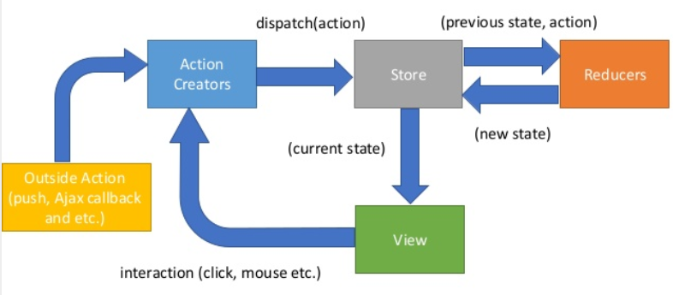
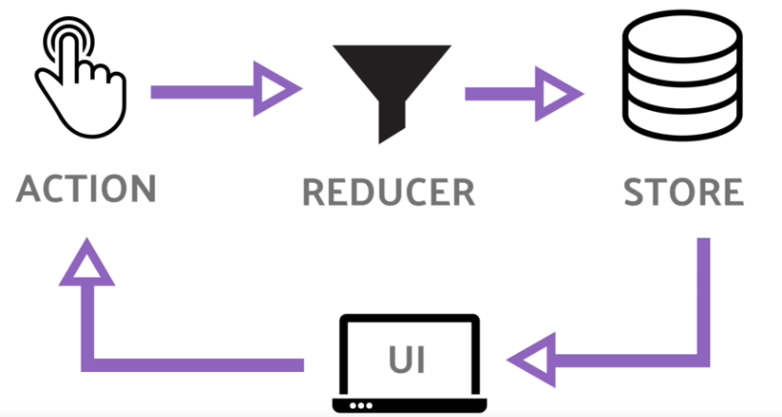
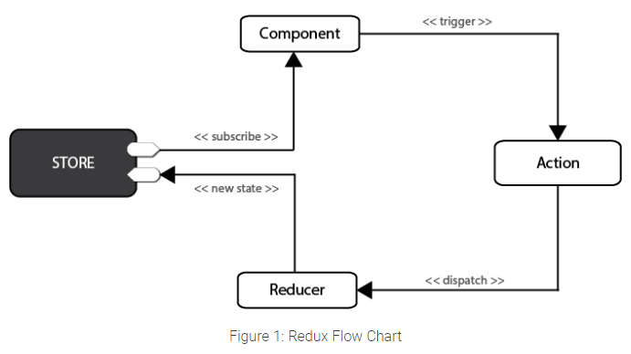
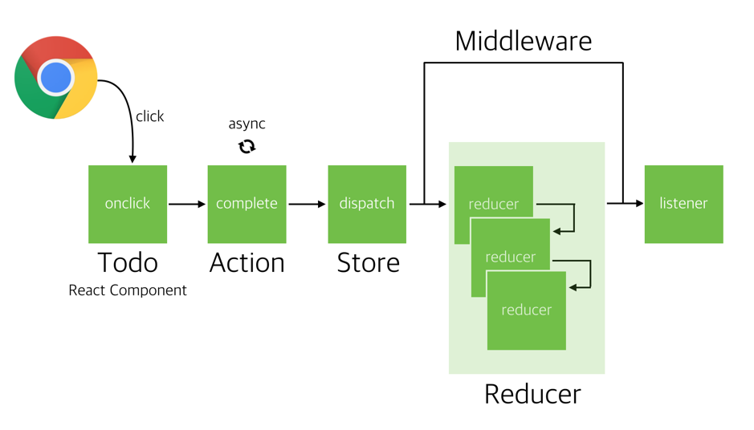
Redux: State Charts
https://www.slideshare.net/gilfink/redux-data-flow-with-angular-77198205
https://medium.freecodecamp.org/how-to-model-the-behavior-of-redux-apps-using-statecharts-5e342aad8f66
https://www.sitepoint.com/getting-started-redux/
2019.4.8 - 9

Slide 51
React - Redux ^{w/o React-Router}
Index.js
AppContainter.js
(currentState)
mapStateToProps
mapDispatchToProps
Store.js
middleware
ActionCreator.js
dispatch(action)
props
ActionCreator.js
App.js
(previouState, action)
props
Component View.js
Root Reducer.js
interaction
(click, etc.)
(newState, initialState)
Component View.js
Child Reducer.js
Child Reducer.js
state
code
props
2019.4.1 – 5, 4.8, 4.9

Slide 52
React - Redux ^{w/ React-Router}
Index.js
App.js
Routes.js
(currentState)
Store.js
Component Containter.js
middleware
mapStateToProps
mapDispatchToProps
dispatch(action)
ActionCreator.js
ActionCreator.js
(previouState, action)
props
Component View.js
Root Reducer.js
interaction
(click, etc.)
(newState, initialState)
Child Reducer.js
Child Reducer.js
state
code
props
2019.4.9

Slide 53
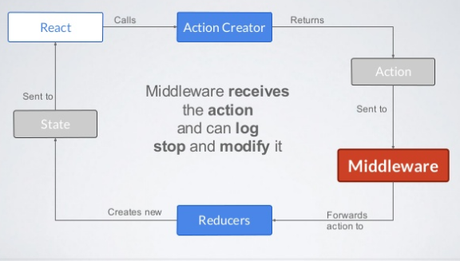
Redux: Middleware
https://www.slideshare.net/visualengin/workshop-22-reactredux-m
2019.4.1 - 5

Slide 54
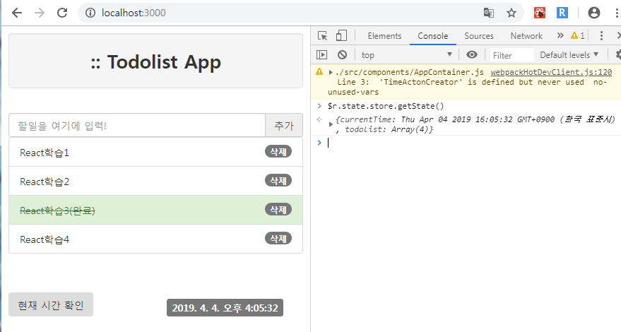
Redux: Redux Devtools
import { createStore, appyMiddleWare, applyMiddleware } from 'redux';
// import TodoReducer from './TodoReducer';
import RootReducer from './RootReducer';
import thunk from 'redux-thunk'
import TimeActionCreator from './TimeActionCreator';
import TodoActionCreator from './TodoActionCreator';
import { composeWithDevTools } from 'redux-devtools-extension';
import invariant from 'redux-immutable-state-invariant';
const logger = (store) => {
return (next) => {
return (action) => {
console.log("------------------------")
console.log("##### action execution:", action)
console.log("##### state before execution:", store.getState())
next(action)
console.log("##### state after execution:", store.getState())
}
}
}
// const TodoStore = createStore(TodoReducer);
// const TodoStore = createStore(RootReducer) ;
// const TodoStore = createStore(RootReducer, applyMiddleware(logger));
/*
const TodoStore = createStore(RootReducer, applyMiddleware(logger, thunk));
export default TodoStore;
*/
let TodoStore
if (process.env.NODE_ENV === 'production') {
TodoStore = createStore(RootReducer, applyMiddleware(logger, thunk));
} else {
const composeEnhancers = composeWithDevTools({...TimeActionCreator, ...TodoActionCreator});
TodoStore = createStore(RootReducer, composeEnhancers(
applyMiddleware(invariant(), thunk)
));
}
export default TodoStore;
2019.4.1 - 5

Slide 55

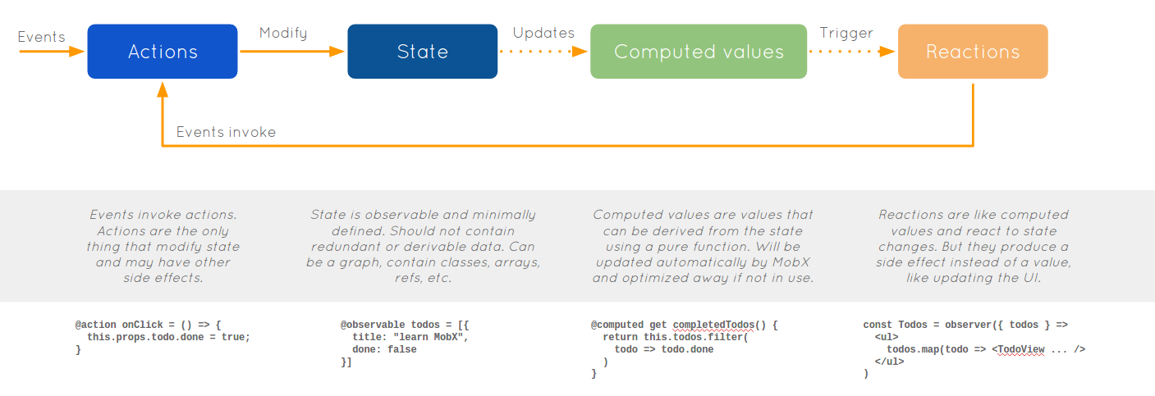
Mobx
Simple, scalable state management
https://github.com/mobxjs/mobx
2019.4.1 - 5

Slide 56
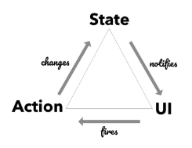
Mobx
MobX Quick Start Guide: Supercharge the client state in your React apps with MobX 1st Edition, Kindle Edition, July 26, 2018
2019.4.1 - 5

Slide 57
Appendix

Slide 58
Tools
local- npm https://www.npmjs.com/package/local-npm
>> nslookup registry.npmjs.org
구굴계산기
Babel https://babeljs.io/repl
Boostrap https://getbootstrap.com/
Codesandbox https://codesandbox.io/

Slide 59

Sites
System Integration(시스템 구축)의 약자 https://namu.wiki/w/SI
https://awesomereact.com
http://sample.bmaster.kro.kr/console/
http://sample.bmaster.kro.kr:8080/
https://velopert.com/2389 >>> JWT (Jason Web Token)
https://velopert.com/2389
Material UI https://material-ui.com/ https://ndb796.tistory.com/216
JSX https://reactjs.org/docs/introducing-jsx.html
https://www.npmjs.com/package/express-history-api-fallback << hash router 사용하기 위해

